Slide 1
Applied Cryptography perfect secrecy, one-time pad, iterated ciphers, substitution-permutation network
Liangfeng Zhang
School of Information Science and Technology
ShanghaiTech University

Slide 2
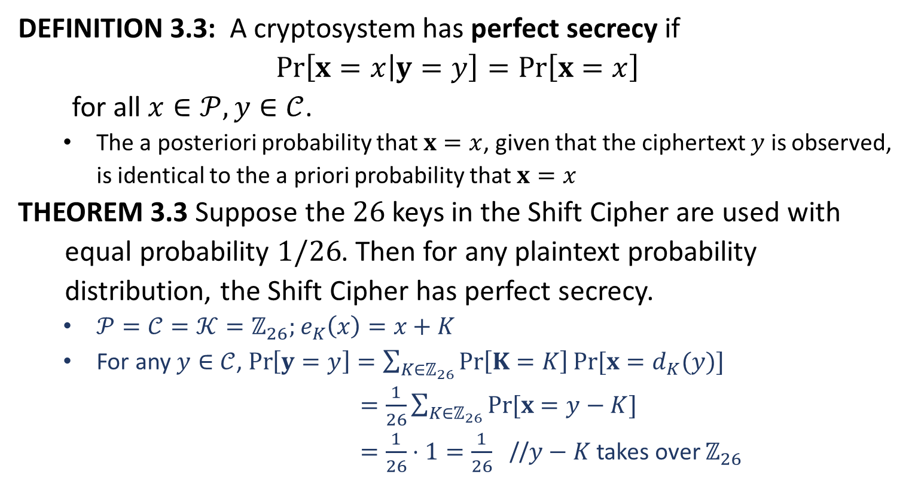
Perfect Secrecy
DEFINITION 3.3: A cryptosystem has perfect secrecy if
$$Pr\left[x=x | y=y\right]=Pr\left[x=x\right]$$
for all $x∈𝒫, y∈𝒞$.
The a posteriori probability that $x=x$, given that the ciphertext $y$ is observed, is identical to the a priori probability that $x=x$
THEOREM 3.3 Suppose the $26$ keys in the Shift Cipher are used with
equal probability $1/26$. Then for any plaintext probability
distribution, the Shift Cipher has perfect secrecy.
$𝒫=𝒞=𝒦=ℤ_{26};$ $e_{K}\left(x\right)=x+K$
For any $y∈𝒞$, $\operatorname{Pr}\left[y=y\right]=\sum_{K∈ℤ_{26}}{\operatorname{Pr}\left[K=K\right]Pr⁡[x=d_{K}(y)]}$
$=\frac{1}{26}\sum_{K∈ℤ_{26}}{Pr⁡[x=y−K]}$
$=\frac{1}{26}⋅1=\frac{1}{26}$ //$y−K$ takes over $ℤ_{26}$

Slide 3
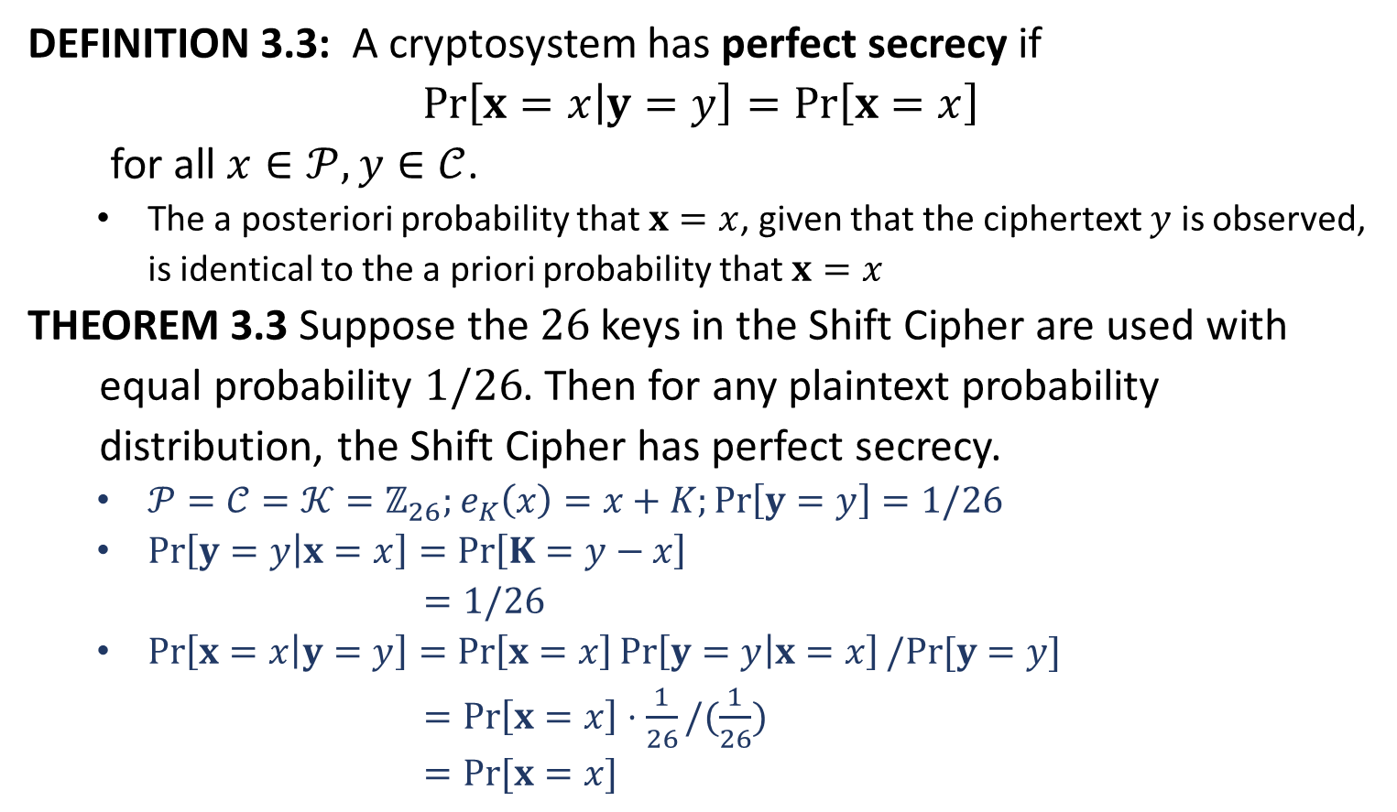
Perfect Secrecy
DEFINITION 3.3: A cryptosystem has perfect secrecy if
$$Pr\left[x=x | y=y\right]=Pr\left[x=x\right]$$
for all $x∈𝒫, y∈𝒞$.
The a posteriori probability that $x=x$, given that the ciphertext $y$ is observed, is identical to the a priori probability that $x=x$
THEOREM 3.3 Suppose the $26$ keys in the Shift Cipher are used with
equal probability $1/26$. Then for any plaintext probability
distribution, the Shift Cipher has perfect secrecy.
$𝒫=𝒞=𝒦=ℤ_{26};$ $e_{K}\left(x\right)=x+K;\operatorname{Pr}\left[y=y\right]=1/26$
$\operatorname{Pr}\left[y=y | x=x\right]=\operatorname{Pr}\left[K=y−x\right]$
$=1/26$
$\operatorname{Pr}\left[x=x | y=y\right]=\operatorname{Pr}\left[x=x\right]\operatorname{Pr}\left[y=y | x=x\right]/Pr⁡[y=y]$
$=\operatorname{Pr}\left[x=x\right]⋅\frac{1}{26}/(\frac{1}{26})$
$=Pr⁡[x=x]$
Perfect Secrecy

Slide 5

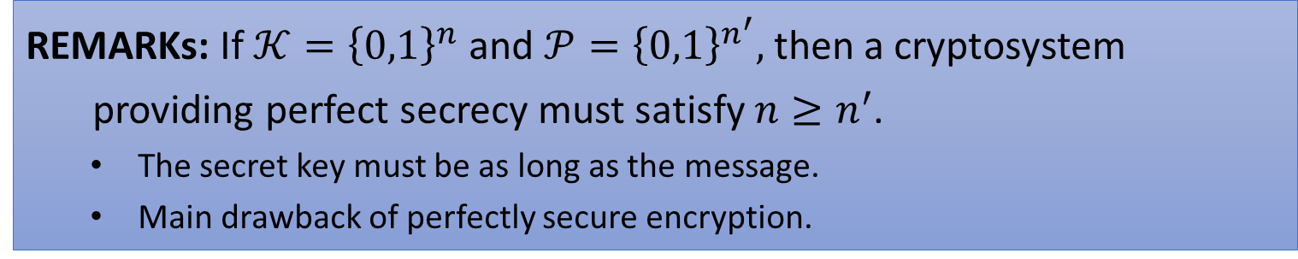
Key Should Be Long
THEOREM: In a cryptosystem $(𝒫,𝒞,𝒦, ℰ,𝒟)$we have that $\left|𝒞\right|≥\left|𝒫\right|.$
Fix $K∈𝒦$.
$∀ x_{1},x_{2}∈𝒫$ such that $x_{1}≠x_{2}$, we have that
$$e_{K}\left(x_{1}\right)≠e_{K}(x_{2})$$
$\left|𝒞\right|≥|𝒫|$
THEOREM: If $(𝒫,𝒞,𝒦, ℰ,𝒟)$provides perfect secrecy, then $\left|𝒦\right|≥|𝒞|$.
$∀x∈𝒫, y∈𝒞$, we have that
$$\operatorname{Pr}\left[y=y | x=x\right]=\frac{\operatorname{Pr}\left[y=y\right]\operatorname{Pr}\left[x=x | y=y\right]}{\operatorname{Pr}\left[x=x\right]}$$
$=Pr⁡[y=y]$
$>0$
$∀x∈𝒫, y∈𝒞$, there is a key $K∈𝒦$ such that $e_{K}\left(x\right)=y$.
Fix $x∈𝒫$. We have that
$$\left|𝒞\right|=|\{e_{K}\left(x\right):K∈𝒦\}|$$
$≤|𝒦|$
REMARKs: If $𝒦={\left\{0,1\right\}}^{n}$ and $𝒫={\left\{0,1\right\}}^{n^{′}},$then a cryptosystem
providing perfect secrecy must satisfy $n≥n^{′}$.
The secret key must be as long as the message.
Main drawback of perfectly secure encryption.

Slide 6
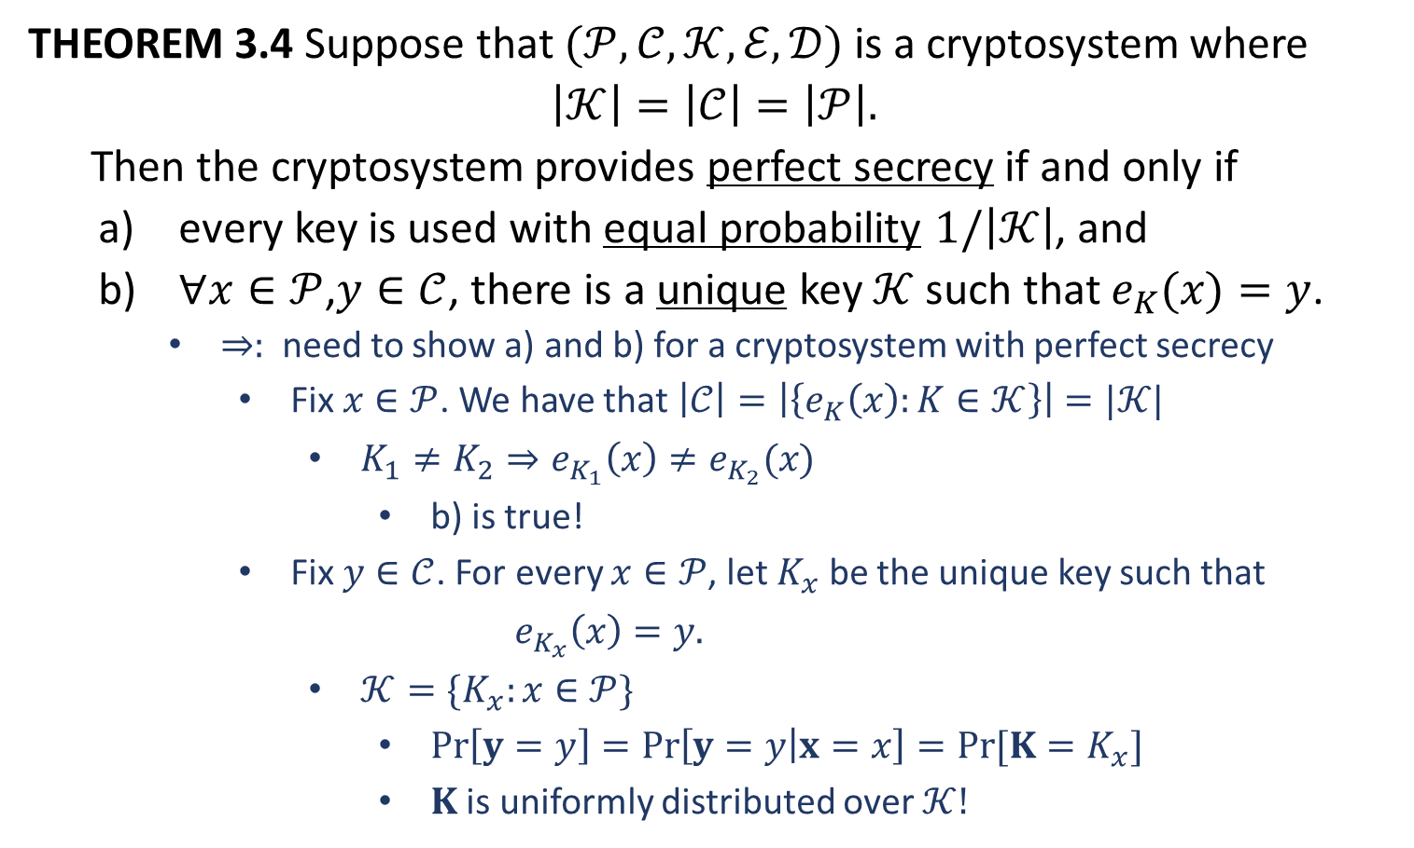
Key Should Be Equally Likely
THEOREM 3.4 Suppose that $(𝒫,𝒞,𝒦, ℰ,𝒟)$ is a cryptosystem where
$$\left|𝒦\right|=\left|𝒞\right|=\left|𝒫\right|.$$
Then the cryptosystem provides perfect secrecy if and only if
every key is used with equal probability $1/\left|𝒦\right|$, and
$∀x∈𝒫$,$y∈𝒞$, there is a unique key $𝒦$ such that $e_{K}(x)=y$.
$⇒:$ need to show a) and b) for a cryptosystem with perfect secrecy
Fix $x∈𝒫$. We have that $\left|𝒞\right|=\left|\left\{e_{K}\left(x\right):K∈𝒦\right\}\right|=|𝒦|$
$K_{1}≠K_{2}⇒e_{K_{1}}\left(x\right)≠e_{K_{2}}(x)$
b) is true!
Fix $y∈𝒞$. For every $x∈𝒫$, let $K_{x}$ be the unique key such that
$$e_{K_{x}}\left(x\right)=y.$$
$𝒦=\{K_{x}:x∈𝒫\}$
$\operatorname{Pr}\left[y=y\right]=\operatorname{Pr}\left[y=y | x=x\right]=Pr⁡[K=K_{x}]$
$K$ is uniformly distributed over $𝒦!$

Slide 7
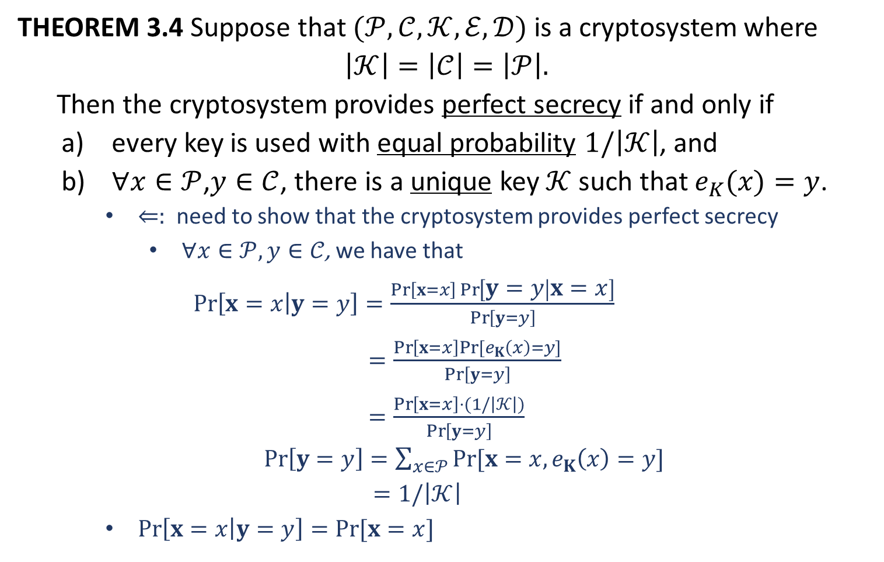
Key Should Be Equally Likely
THEOREM 3.4 Suppose that $(𝒫,𝒞,𝒦, ℰ,𝒟)$ is a cryptosystem where
$$\left|𝒦\right|=\left|𝒞\right|=\left|𝒫\right|.$$
Then the cryptosystem provides perfect secrecy if and only if
every key is used with equal probability $1/\left|𝒦\right|$, and
$∀x∈𝒫$,$y∈𝒞$, there is a unique key $𝒦$ such that $e_{K}(x)=y$.
$⇐:$ need to show that the cryptosystem provides perfect secrecy
$∀x∈𝒫, y∈𝒞$, we have that
$\operatorname{Pr}\left[x=x | y=y\right]=\frac{\operatorname{Pr}\left[x=x\right]\operatorname{Pr}\left[y=y | x=x\right]}{\operatorname{Pr}\left[y=y\right]}$
$=\frac{\operatorname{Pr}\left[x=x\right]Pr⁡[e_{K}\left(x\right)=y]}{\operatorname{Pr}\left[y=y\right]}$
$=\frac{\operatorname{Pr}\left[x=x\right]⋅(1/\left|𝒦\right|)}{\operatorname{Pr}\left[y=y\right]}$
$\operatorname{Pr}\left[y=y\right]=\sum_{x∈𝒫}{Pr⁡[x=x, e_{K}\left(x\right)=y]}$
$=1/\left|𝒦\right|$
$\operatorname{Pr}\left[x=x | y=y\right]=\operatorname{Pr}{[x=x]}$

Slide 9
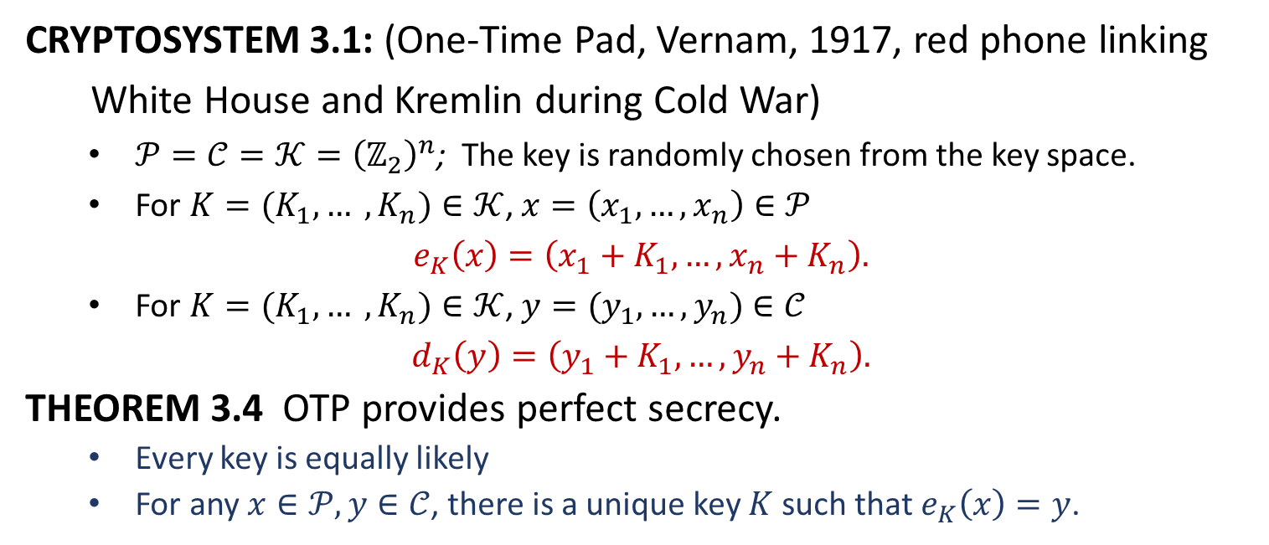
One-Time Pad
CRYPTOSYSTEM 3.1: (One-Time Pad, Vernam, 1917, red phone linking
White House and Kremlin during Cold War)
$𝒫=𝒞=𝒦={\left(ℤ_{2}\right)}^{n}$; The key is randomly chosen from the key space.
For $K=(K_{1}, … , K_{n})∈𝒦$, $x=\left(x_{1}, …, x_{n}\right)∈𝒫$
$$e_{K}\left(x\right)=\left(x_{1}+K_{1},…, x_{n}+K_{n}\right).$$
For $K=(K_{1}, … , K_{n})∈𝒦$,$y=(y_{1}, …,y_{n})∈𝒞$
$$d_{K}\left(y\right)=\left(y_{1}+K_{1}, …, y_{n}+K_{n}\right).$$
THEOREM 3.4 OTP provides perfect secrecy.
Every key is equally likely
For any $x∈𝒫, y∈𝒞$, there is a unique key $K$ such that $e_{K}\left(x\right)=y$.

Slide 11



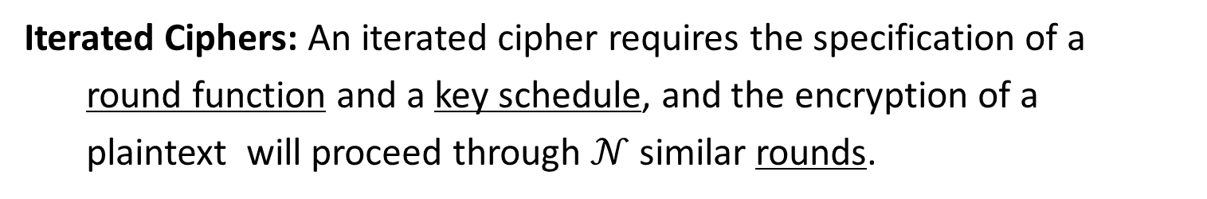












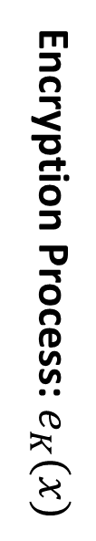
(Modern-Day) Block Ciphers
Iterated Ciphers: An iterated cipher requires the specification of a
round function and a key schedule, and the encryption of a
plaintext will proceed through $𝒩$ similar rounds.
$$w^{0} (x)$$
Round Key
$$K$$
$$g$$
$$K^{1}$$
key schedule
Round 1
$$w^{1}$$
$$g$$
$$K^{2}$$
Round 2
Encryption Process: $e_{K}(x)$
$$w^{2}$$
$$⋮$$
$$⋮$$
$$⋮$$
$$w^{𝒩−1}$$
$$g$$
$$K^{𝒩}$$
Round $𝓝$
$$w^{𝒩} (y)$$
State

Slide 12



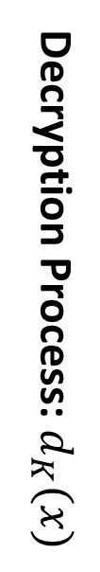

(Modern-Day) Block Ciphers
Iterated Ciphers: An iterated cipher requires the specification of a
round function and a key schedule, and the encryption of a
plaintext will proceed through $𝒩$ similar rounds.
$$w^{0} (x)$$
$$K$$
$$g^{−1}$$
$$K^{1}$$
key schedule
Round 1
$$w^{1}$$
$$g^{−1}$$
$$K^{2}$$
Round 2
Decryption Process: $d_{K}(x)$
$$w^{2}$$
$$⋮$$
$$⋮$$
$$⋮$$
$$w^{𝒩−1}$$
$$g^{−1}$$
$$K^{𝒩}$$
Round $𝓝$
$$w^{𝒩} (y)$$
$$g^{−1}\left(g\left(w,k\right),k\right)=w$$

Slide 14


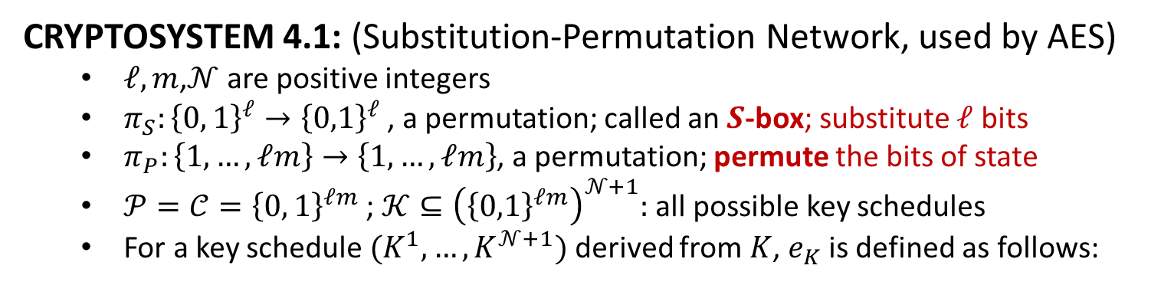









Substitution-Permutation Network
CRYPTOSYSTEM 4.1: (Substitution-Permutation Network, used by AES)
$ℓ,m$,$𝒩$ are positive integers
$π_{S}:{\left\{0, 1\right\}}^{ℓ}→{\left\{0,1\right\}}^{ℓ}$, a permutation; called an $S$-box; substitute $ℓ$ bits
$π_{P}:\left\{1,…,ℓm\right\}→\left\{1,…,ℓm\right\}$, a permutation; permute the bits of state
$𝒫=𝒞={\left\{0, 1\right\}}^{ℓm}$ ; $𝒦⊆{\left({\left\{0,1\right\}}^{ℓm}\right)}^{𝒩+1}:$ all possible key schedules
For a key schedule $(K^{1}, …, K^{𝒩+1})$ derived from $K$, $e_{K}$ is defined as follows:
$$x=(x_{1},x_{2},…,x_{ℓm})$$
$$x_{〈1〉}$$
$$x_{〈2〉}$$
$$⋯$$
$$x_{〈m〉}$$
$$⋯$$
$ℓ$ bits
$ℓ$ bits
$$⋯$$
$ℓ$ bits
$$x_{〈i〉}=(x_{\left(i−1\right)ℓ+1},…,x_{iℓ})$$

